Slide 1
Organizational Behavior
Topic: Organization Culture
Dr. C. Vijaya Banu
Associate Professor , School of Management
SASTRA Deemed University, Thanjavur – 613 401
vijayabanu@mba.sastra.edu

Slide 2
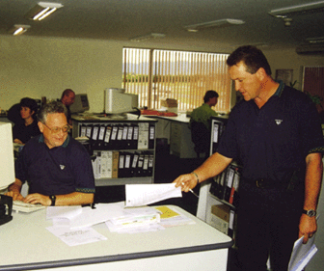
Organisational culture defined
The basic pattern of shared assumptions, values and beliefs considered to be the correct way of thinking about and acting on problems and opportunities facing the organisation.
Courtesy of Melso Minerals (Matamata) Ltd

Slide 3
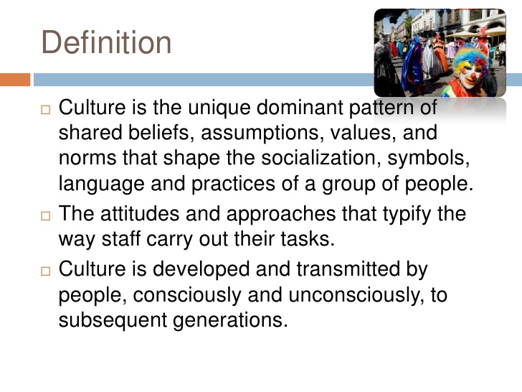

Slide 4
Elements of organisational culture

Slide 5
Elements of Organizational Culture

Slide 6

What Is Organizational Culture?
Organizational Culture
A common perception held by the organization’s members; a system of shared meaning.
The basic pattern of shared values and assumptions governing the way employees within an organization think about and act on problems and opportunities.
Characteristics:
Innovation and risk taking
Attention to detail
Outcome orientation
People orientation
Team orientation
Aggressiveness
Stability

Slide 7
Do Organizations Have Uniform Cultures?
Dominant Culture - Expresses the core values that are shared by a majority of the organization’s members.
Subcultures - Mini-cultures within an organization, typically defined by department designations and geographical separation.
Core Values - The primary or dominant values that are accepted throughout the organization.
Strong Culture - A culture in which the core values are intensely held and widely shared.

Slide 9
Organizational Culture
Enable Functions
Liabilities
Controlling behavior
Defining boundaries
Conveying identity
Promoting commitment
Blocking mergers
Inhibiting diversity
Inhibiting change
Blocking acquisitions

Slide 10
Organisational subcultures
Located throughout the organisation
Can support or oppose (countercultures) firm’s dominant culture
Two functions of countercultures:
provide surveillance and evaluation
source of emerging values

Slide 11
Artefacts: rituals and ceremonies
Rituals
programmed routines
eg conducting meetings
Ceremonies
planned activities for an audience
eg award ceremonies

Slide 12
Artefacts: organisational language
Words used to address people, describe clients, etc
Leaders use phrases and metaphors as cultural symbols
Language also found in subcultures

Slide 14
Benefits of strong corporate cultures
Social control
Strong
organisational
culture
Social glue
Aids sense-making

Slide 15
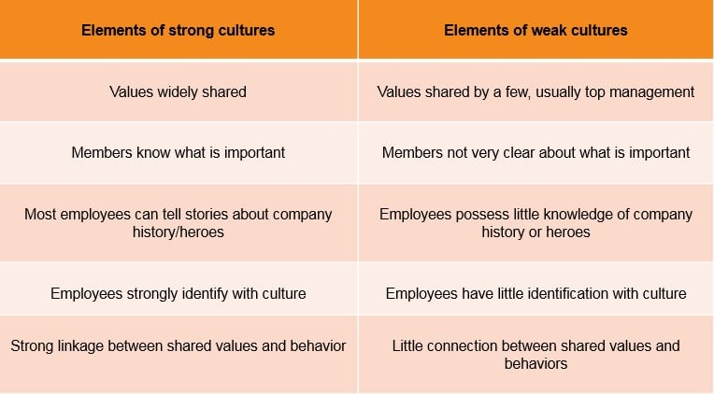

Slide 16
Problems with strong cultures
Culture content might be incompatible with the organisation’s environment
Strong cultures focus attention on one mental model
Strong cultures suppress dissenting values from subcultures

Slide 17
Adaptive organisational cultures
External focus − firm’s success depends on continuous change
Focus on processes more than goals
Strong sense of ownership
Proactive − seek out opportunities

Slide 18
Merging organisational cultures
Assimilation
Acquired company embraces acquiring firm’s culture
Deculturation
Acquiring firm imposes its culture on unwilling acquired firm
Integration
Both cultures combined into a new composite culture
Separation
Merging companies remain separate with their own culture

Slide 19
Strengthening organisational culture
Founders and leaders
Strengthening
organisational
culture
Selection
and
socialisation
Culturally
consistent
rewards
Managing the
cultural
network
Stable
workforce

Slide 20
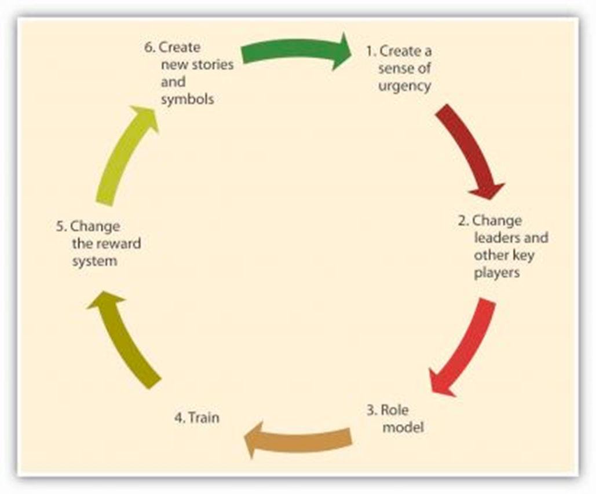
Steps to Changing Established Cultures

Slide 23
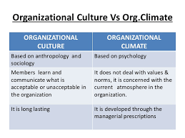

Slide 24
What Is Organizational Climate?
Organizational climate concerns the policies and practices of an organization or unit of an organization. It concerns the behaviors that are encouraged and supported. It is communicated in several ways.
Policies: These are the written rules for the behaviors that people should and should not do. Policies describe how things should be done.
Practices: These are the behaviors that employees and their supervisors engage in, in other words, how policies are or are not enacted.
What is encouraged and discouraged. These are the expectations that supervisors and other employees express about what each employee should and should not do. For Beth is was customer service and for Mike it was efficiency.
Where the rewards are. Nothing expresses expectations like rewards. These can be monetary, such as bonuses for high sales volume, or nonmonetary, such as praise for a job well done.

Slide 25
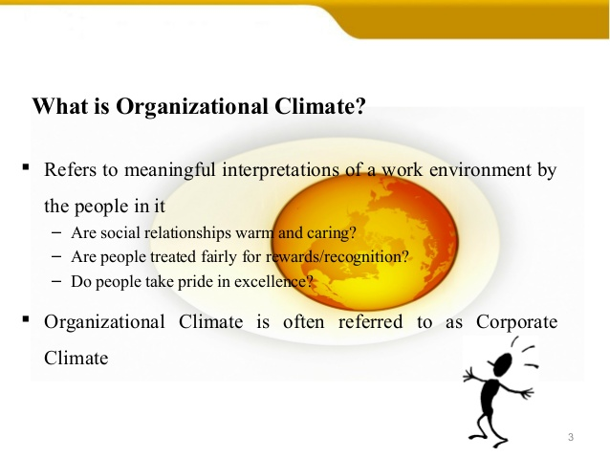


Slide 26
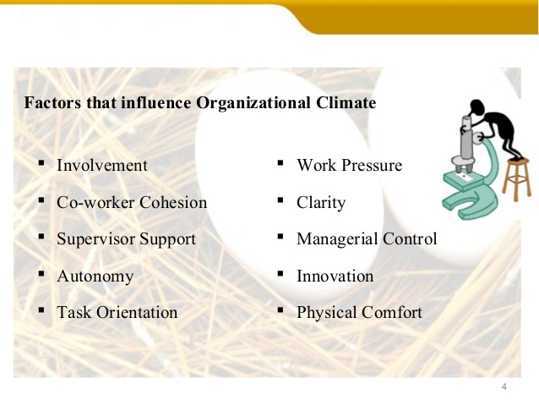

Slide 27
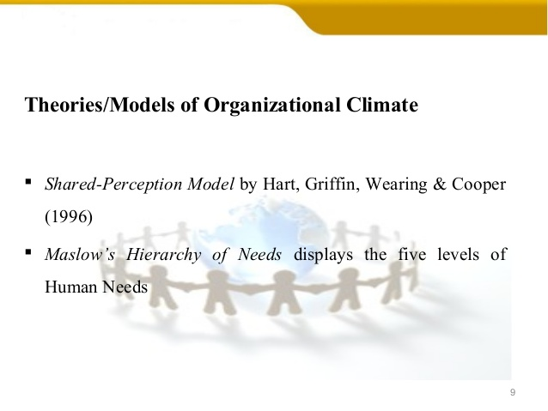

Slide 28
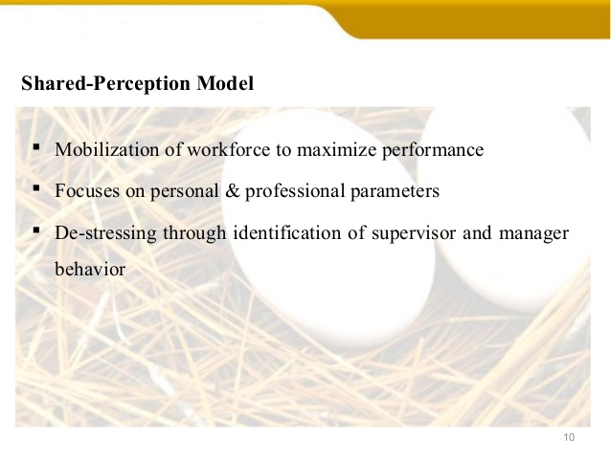

Slide 29
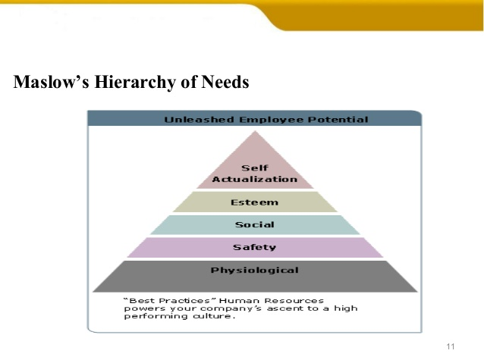

Slide 30
Reasons for changes in work culture
A new management, a new team leader, a new boss brings a change in the organization culture. A new employee but obvious would have new ideas, concepts and try his level best to implement them. He would want the employees to work according to him. His style of working, behaviour and ideologies would definitely bring a change in the work culture.
Financial loss, bankruptcy, market fluctuations also lead to change in the work culture of the organization. When an organization runs into losses, it fails to give rewards and appraisals to the employees as it used to give earlier.

Slide 31
Reasons for changes in work culture
Acquiring new clients might cause a change in the work culture. The employees might have to bring about a change in their style of working to meet the expectations of the new clients.
The employees on their own might realize that they need to bring a change in their attitude, perception and style of working to achieve the targets at a much faster rate. Such self-realization also changes the work culture

Slide 32
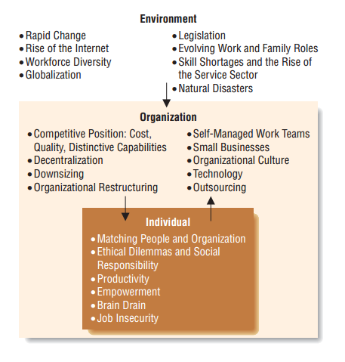

Slide 33
Differences
The terms climate and culture are often used interchangeably, but they are not the same concept. Climate is part of culture and reflects the sorts of behaviors that are encouraged and presumably engaged in within an organization. Culture is far more than encouraged behavior patterns.
Culture includes artifacts (e.g., the sorts of clothes people wear), symbols (e.g., the company logo), technology (e.g., salespeople’s use of tablets to ring up sales), and values (e.g., profitability). Although these aspects of culture might support the climate, they go beyond climate, and much of organizational culture might not link to climate.

Slide 34
